Slide 1
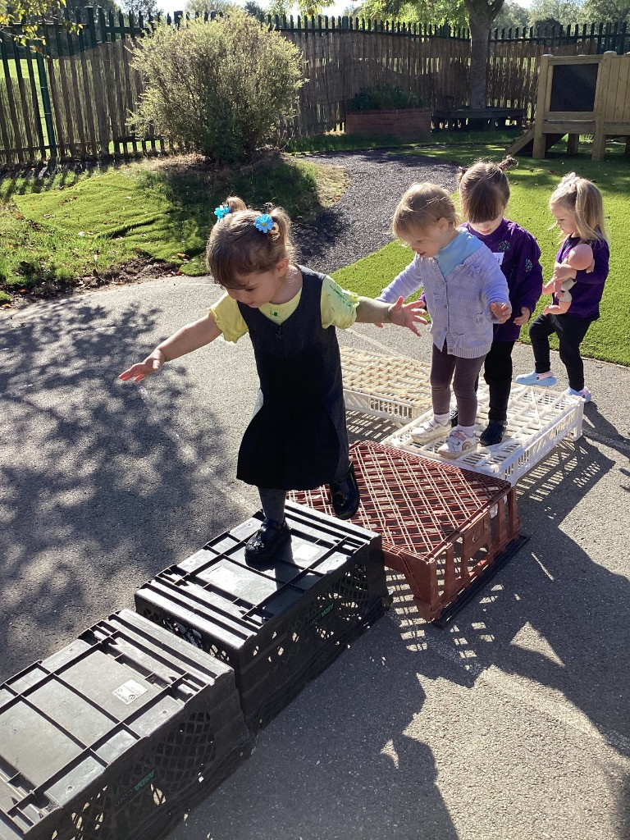
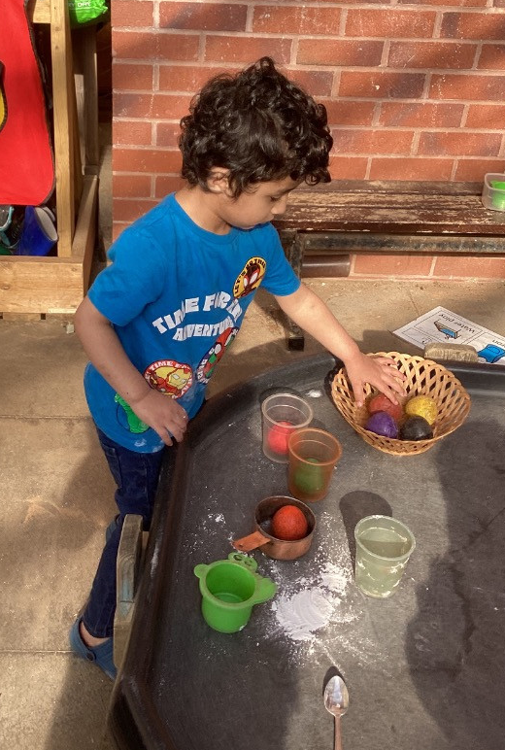
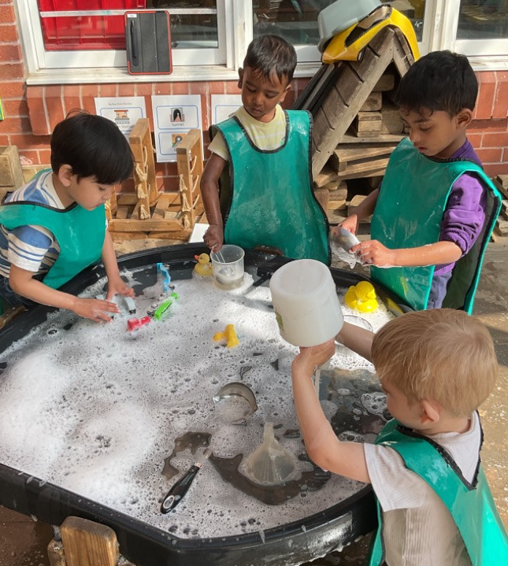


Wyndham Park Nursery School
SEND Information Report 2025–2026

Slide 2

Introduction
Every child is unique and special.
We help ALL children reach their full potential.
If your child needs extra help, we are here to work with you to ensure that every child gets the right support to thrive.

Slide 3

What is SEND?
SEND means Special Educational Needs and Disabilities.
Some children need extra help with learning, speaking, moving, and understanding or expressing their feelings.
We follow the law called the SEND Code of Practice.
SEND code of practice: 0 to 25 years - GOV.UK

Slide 4

The Four Areas of Need
1. Communication and Interaction
2. Cognition and Learning
3. Social, Emotional and Mental Health
4. Sensory and/or Physical Needs

Slide 5

Who helps with SEND?
Our SENCo is Driffa Jenkins.
Teachers and support staff support children every day.
Julie Mellor oversees SEND across the Federation.

Slide 6

If you’re worried about your child
Arrange to talk to your child’s key person or teacher first.
You can also speak to Driffa Jenkins our Nursery School SENCo. Driffa.Jenkins@wyndhampark.lincs.sch.uk
We’ll listen and work together to support your child with their next steps.

Slide 7
What happens when you tell us
We will listen carefully and talk about what we see in school.
We might complete additional observations on your child to learn more.
Together we will plan to support your child following our SEND Journey.

Slide 8
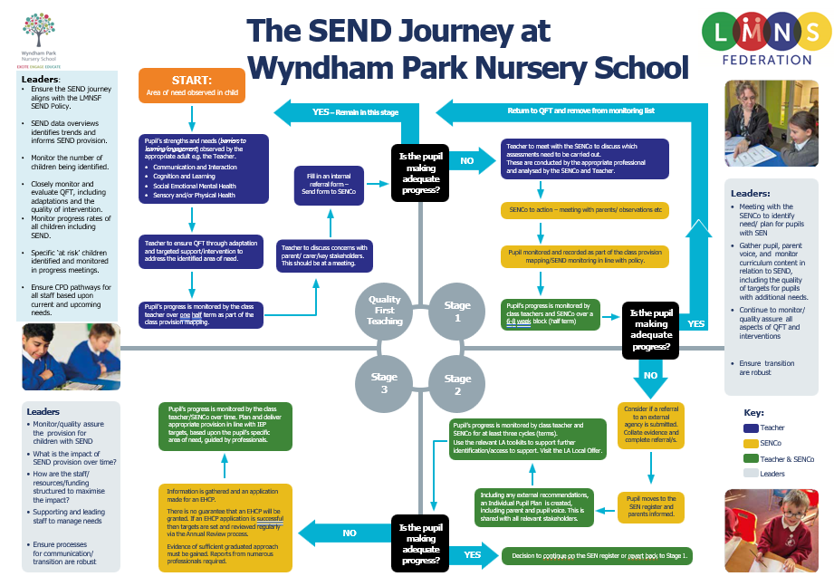

Slide 9
Early identification
We notice if a child is not making adequate progress early on.
We talk to families quickly so we can help and support straight away.
Small changes can make a BIG difference.

Slide 10
Assess, Plan, Do, Review
We follow a simple cycle:
1. Assess – find out what your child needs.
2. Plan – decide what will help.
3. Do – put the support in place.
4. Review – see how it’s going and change if needed.

Slide 11
How we support children day-to-day
We use small groups, extra adult time, or special resources.
We make learning fun and hands-on.
We celebrate every little step forward!

Slide 12
How we work with you
Families know their children best so we will work with you every step of the way to capture your child’s voice and follow their strengths to help them make progress.
We will involve families in setting Smart Goals and invite you to share ideas that work well and celebrate progress.
We will share information about support services that you can access through the SEND Local Offer. SEND Local Offer – Lincolnshire County Council

Slide 13
How we include your child in everything
We make sure all children join in play and learning experiences both inside and outdoors.
We adapt activities so everyone can take part.
Every child belongs at Wyndham Park Nursery School.

Slide 14
Staff training and expertise
Our staff learn new skills every year to support children with SEND. We received the Dingley's Promise Mark of Achievement in March 2025 as all of our staff have completed the first 5 modules of the Early Years Inclusion Training
Staff are highly skilled and keep up to date with effective strategies that support children in all areas of SEND, working together with other professionals where appropriate.
We share what we learn with each other and our families through proactive communication.

Slide 15
Working with outside experts
Sometimes, with your consent, we ask for help from specialists like:
Portage
Early learning and portage support service – Lincolnshire County Council
Speech and Language Therapists
Time to Play
Early Support Learning Provision | www.eyalliance.org.uk
Educational Psychologists
Early Years Specialist Teachers
Health Visitors
AskSALL – SEND Advice Line for LincolnshireSEND Advice Line for Lincolnshire (Ask SALL) – How to get help - Lincolnshire County Council

Slide 16
Supporting feelings and behaviour
We use a Total Communication Approach with Makaton Signs, Visual Aids and Speech to help children understand their feelings.
We have carefully designed our spaces, with natural materials, low lighting and plants to help children feel calm , regulated and ready to learn.
We celebrate diversity and teach children to be kind, share, and take turns with each other and respect each other’s differences.

Slide 17
Medical needs
Some children have Individual Health Plans to help keep them safe. These are written with families and regularly reviewed..
We work with families and professionals to meet the medical needs of the children in our care.
https://www.boston-nur.lincs.sch.uk/attachments/download.asp?file=61&type=docx
We follow the Equality Act 2010 to make any reasonable adjustments that are required to support children.

Slide 18
Education, Health and Care Plans
Some children need extra support through an EHCP.
Identifying and supporting SEND – What happens if there are still issues? - Lincolnshire County Council
An EHCP is a legal plan written by the Local Authority. Liaise will support families with any questions around the EHCP process.
Homepage – Liaise Lincolnshire
We support families through this process by completing the Education and Health Care Needs Assessment together through the EHC Hub.
https://ehchub.lincolnshire.gov.uk/

Slide 19
What to do if you’re unhappy or want to appeal
Please speak to Holly Stock-Cheekooree (Head Teacher) first.
We want to sort things out quickly and fairly.
You can also contact the Local Authority or SENDIASS.

Slide 20
Useful contacts
Head of School: Holly Stock-Cheekooree
SENCo: Driffa Jenkins
Email: holly.stock-cheekooree@wyndhampark.lincs.sch.uk
Driffa.Jenkins@wyndhampark.lincs.sch.uk
Phone: 01476 563966
Lincolnshire Local Offer: www.lincolnshire.gov.uk/send-local-offer
SENDIASS:
www.lincolnshire.gov.uk/sendiass

